Slide 1

MF Company GmbH
An e-commerce platform where every product is special
Source: https://github.com/uogbonda/SQL-query-on-MF-company-performance

Slide 2
Executive Summary
Objective
Detailed story of company’s growth using monthly trended performances using Traffic analysis, website measurement ,testing and optimization.
Analyze current performance , provide conversion funnel from home and lander-1 page.
Key findings
The order volume from March to November was 4 times more. The session increased month by month.
Brand campaigns sessions increased from 8 to 383 sessions and orders from 0 to 17.
Desktop device produced 95% of the total sessions while 5% of the session is from the mobile device.
The organic and direct_type sessions increased from 8 and 9 in March, to 428 and 440 in November respectively.
After performing a A/B split test on old homepage and new homepage, The conversion rate for homepage was 3.18% while new homepage was 4.06%. Having an incremental conversion value of 0.0088.
From 29th July 2012, we have had 50 extra orders each month.
The conversion funnel from new homepage to “thank_you” page had a better conversion than the old homepage.
Recommendations
Increase bids on desktop as the conversion rate was 3.74% compared to mobile device with 0.97% rate.
Fully switch over to the new homepage. As the overall bounce rate did come down over the time period.
Focus on the low click rates of the landing page, mr_fuzzy and billing page.
Perform user analysis.
Source: https://github.com/uogbonda/SQL-query-on-MF-company-performance

Slide 3
Table of Content
Conversion funnel (A/B testing) 4
Click rate of old_homepage and new_hompage 5
Utm_Source 6
Sessions on desktop and mobile device 7
Orders from desktop and mobile device 8
Conclusion 9
Recommendations 10
References 11
Source: https://github.com/uogbonda/SQL-query-on-MF-company-performance

Slide 4
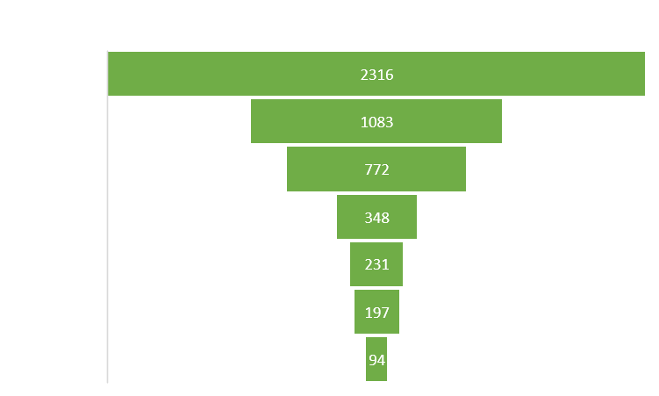
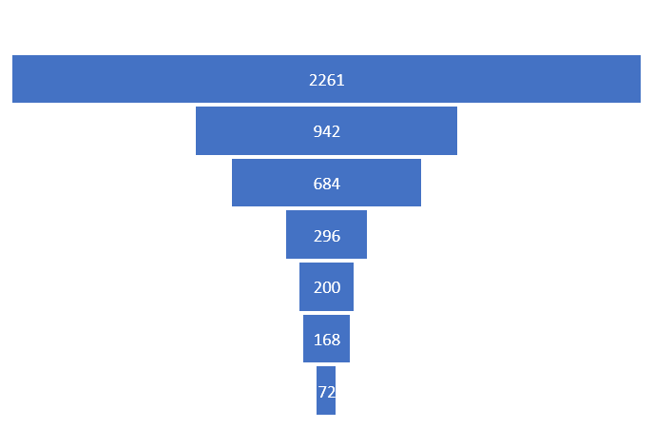
Conversion funnel (A/B testing)

Slide 5

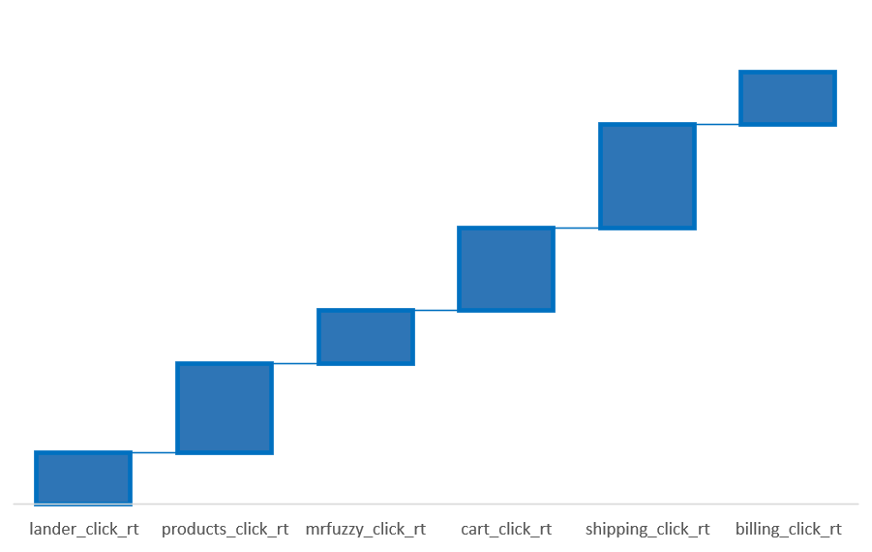
Click rate of old_homepage and new_hompage

Slide 6
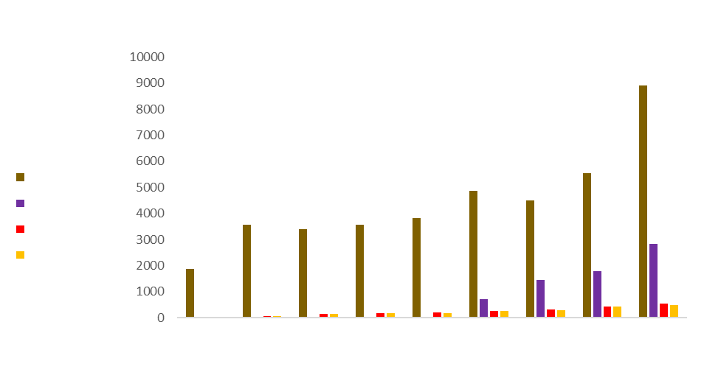
Utm_Sources

Slide 7
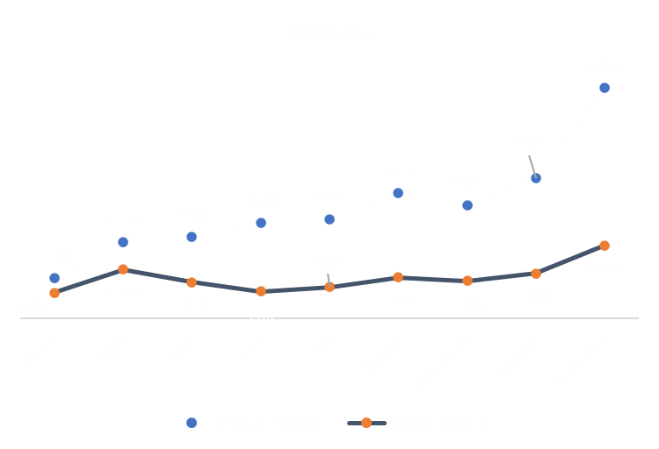
Sessions on desktop and mobile device

Slide 8
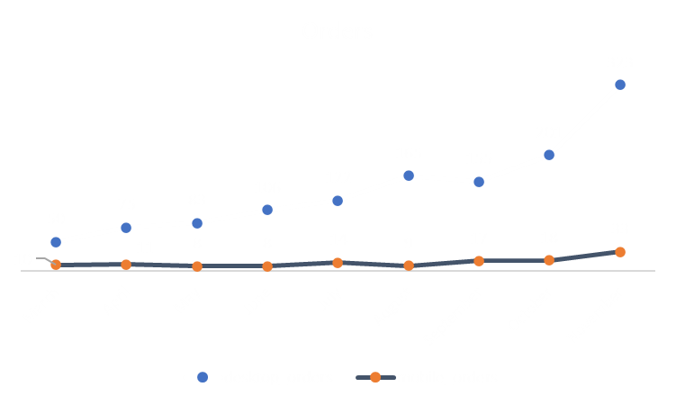
Orders from desktop and mobile device

Slide 9
Conclusion
From the analysis on the company’s website, the following were the findings:
From the A/B testing of the old and new homepage, The new page had better conversion rate and click rate. The conversion funnel did illustrate a detailed journey of our visitors on the website.
There are only two device types used on the website which are the desktop and mobile device. The desktop device had more sessions and orders than the visitors using their mobile devices.
Further analysis was conducted on this with the Marketing director and the developer team. The desktop was still preferred from our users behaviour.
Gsearch source had the most sessions from March to November. In July, bsearch session was 44 but in August, it increased to 705, 1439(September), 1781(October) and 2840 in November.

Slide 10
Recommendation
Increase bids on desktop as the conversion rate was 3.74% compared to mobile device with 0.97% rate.
The billing page had a high bounce rate. It would be advisable to perform a A/B test. Having a 50/50 split test on old and new billing page.
Perform product analysis to know which products gets to checkout whereby getting a purchasing funnel analysis.
Perform user analysis.
Source: https://github.com/uogbonda/SQL-query-on-MF-company-performance

Slide 11
Reference
Advanced SQL: MySQL Data Analysis & Business Intelligence: https://www.udemy.com/course/advanced-sql-mysql-for-analytics-business-intelligence/
MySQL: https://github.com/uogbonda/SQL-query-on-MF-company-performance/blob/main/MID%20COURSE%20PROJECT.sql
Portfolio: https://uogbonda.github.io
Source: https://github.com/uogbonda/SQL-query-on-MF-company-performance

